Slide 1
What’s Cooking
Eka Renardi

Slide 2
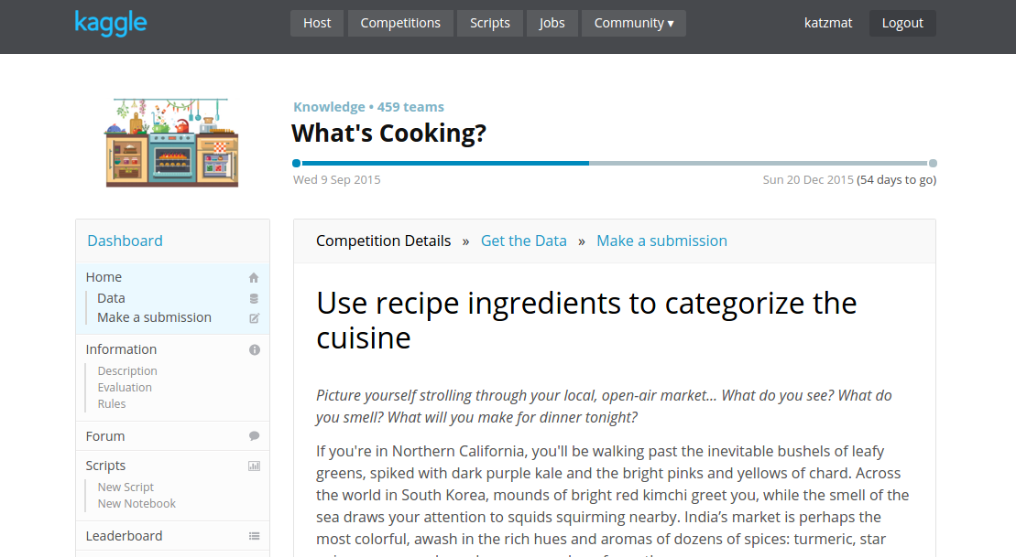
Kaggle Competition

Slide 3
Problem
Classify ‘cuisine’ based on ‘ingredients’

Slide 4
Data
Provided by Yummly
Text data
39,000+ observations
3 Columns:
id: numeric, unique identifier
cuisine: text, 20 classes
ingredients: list of text

Slide 5
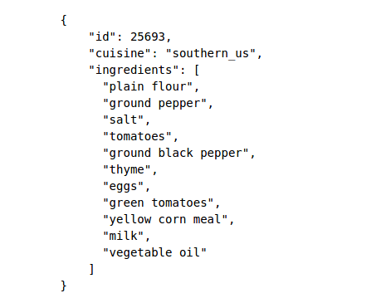
Sample Data

Slide 6
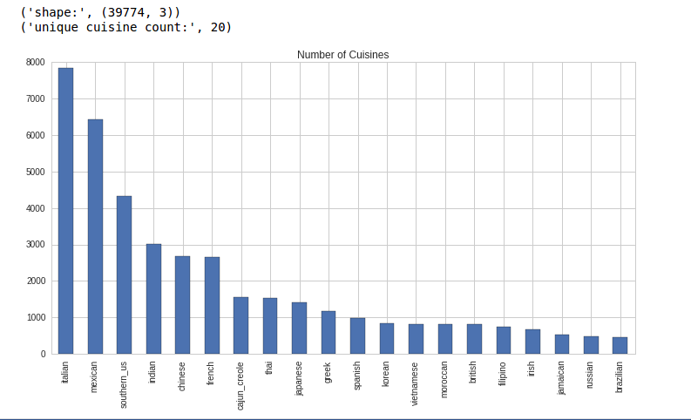
Cuisine
brazilian
british
cajun_creole
chinese
filipino
french
greek
indian
irish
italian
jamaican
japanese
korean
mexican
moroccan
russian
southern_us
spanish
thai
vietnamese

Slide 7
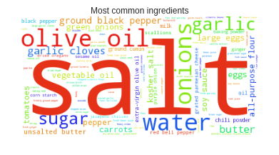
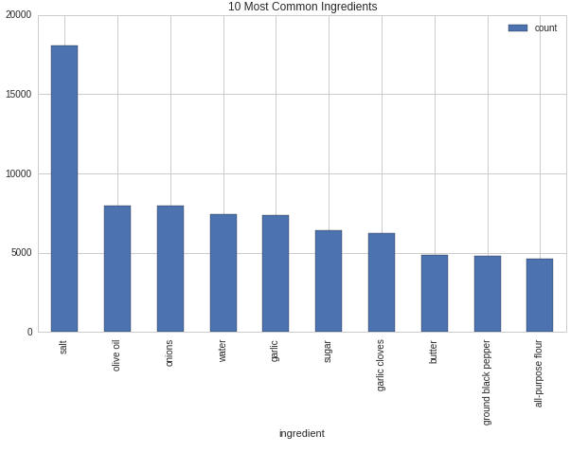
Ingredients
What’s the most common ingredients

Slide 8
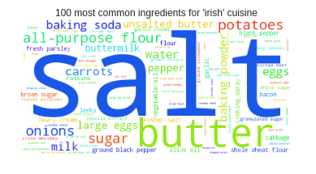
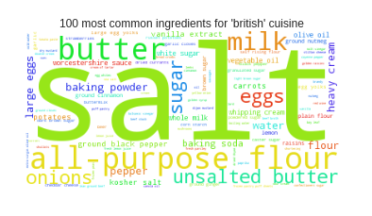
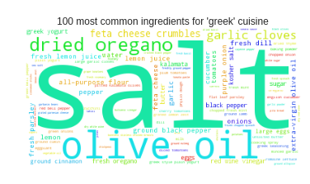
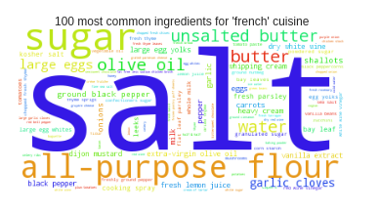
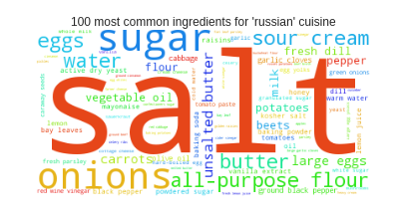
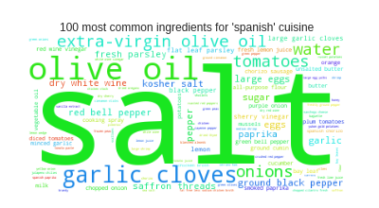
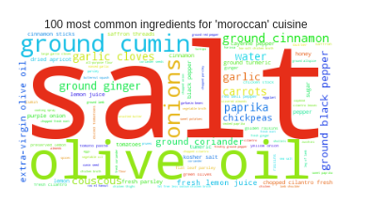
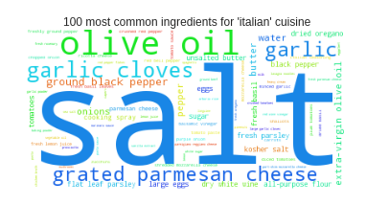
Ingredients (Europe)

Slide 9
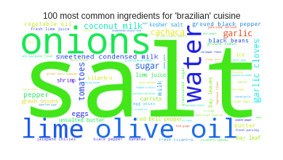
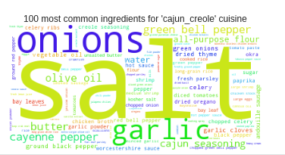
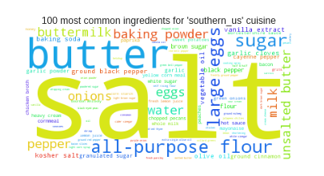
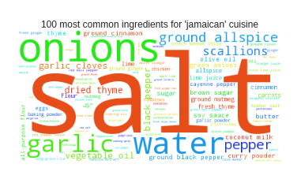
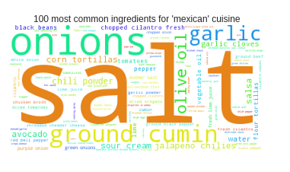
Ingredients (Americas)

Slide 10
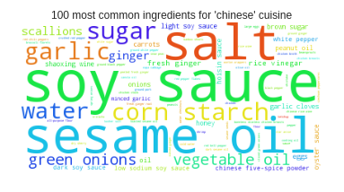
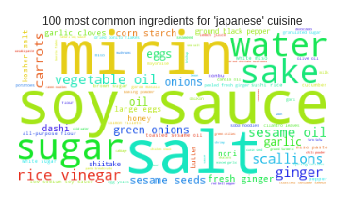
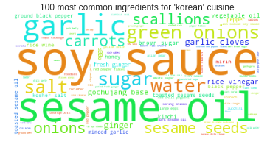
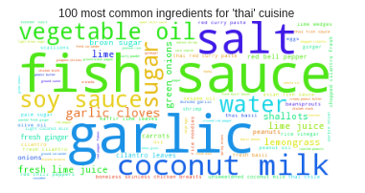
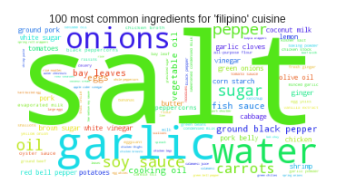
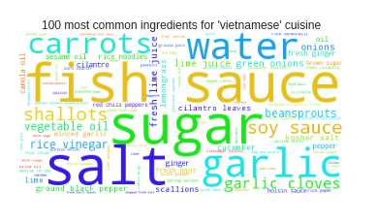
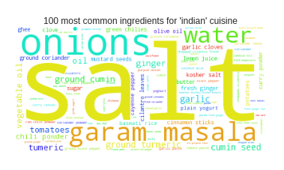
Ingredients (Asia)

Slide 11
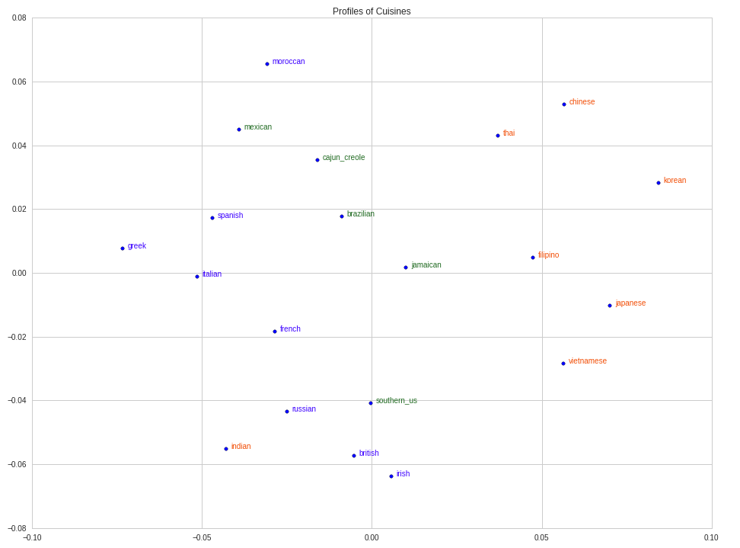
Ingredients <-> Cuisine Relationship

Slide 12
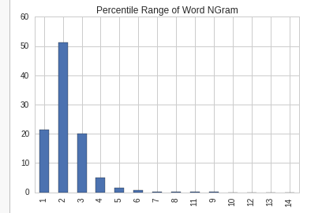
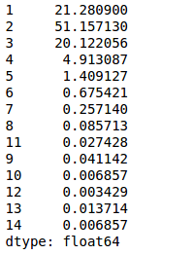
Ingredients (Word Ngram)
# words in an ingredient (e.g. Salt = 1 word, Black Pepper = 2 words)

Slide 13
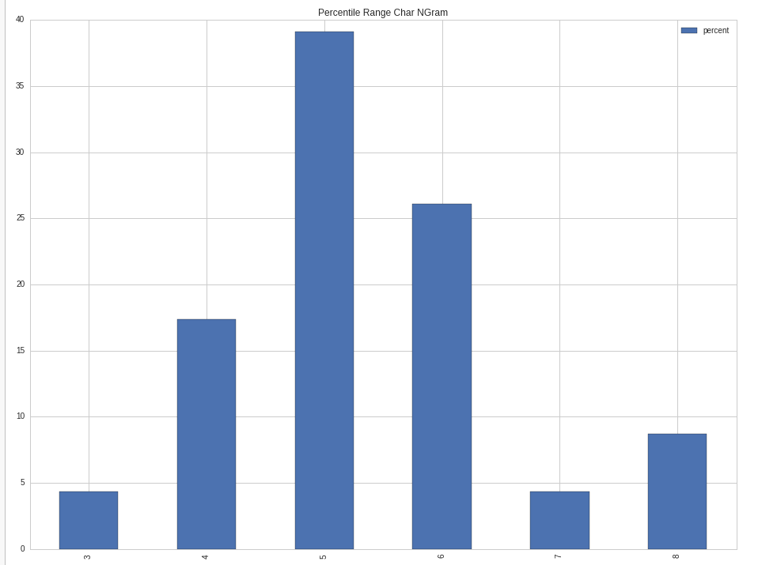
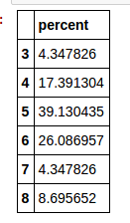
Ingredients (Char NGram)
# characters per word (e.g. Salt = 4 chars)

Slide 14
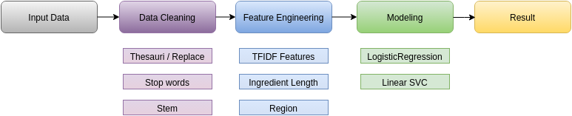
Model Building

Slide 15
Data Cleaning
Word replacement (e.g. Philadelphia Cream Cheese -> cream cheese)
Read from a text file (thesauri.txt)
Stop words (e.g. and, &)
Read from a text file (stopwords.txt)
Stemming (e.g. apples -> apple)

Slide 16
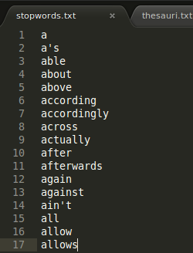
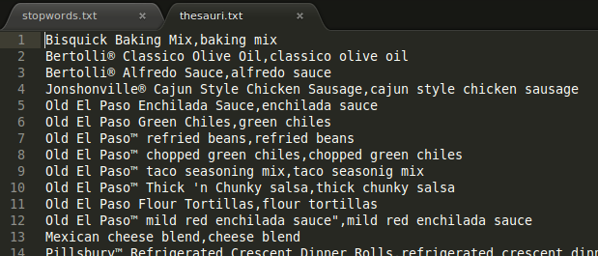
Data Cleaning Files

Slide 17
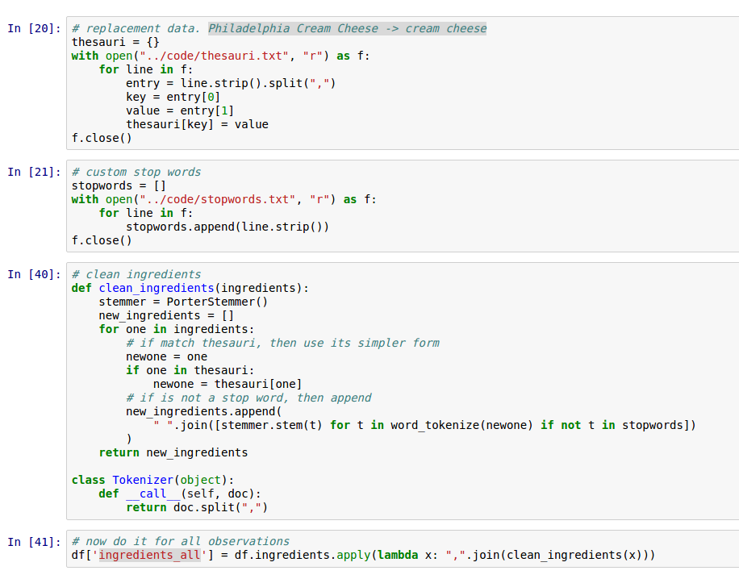
Data Cleaning Code

Slide 18
Feature Engineering
TFIDF features: ngram, max_features
Ingredient length
Region encoding (work in progress…)

Slide 19
Modeling
Logistic Regression. Classic classification algorithm.
Linear SVC. Large dimensions.

Slide 20
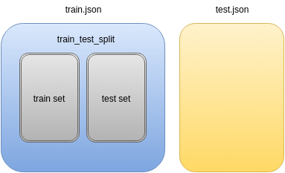
Model Building
Use cross validation, and GridSearchCV with 5 folds.
Uses ‘Pipeline’ heavily
Scoring on ‘Accuracy’
Test on entire train.json
Default train test split

Slide 21
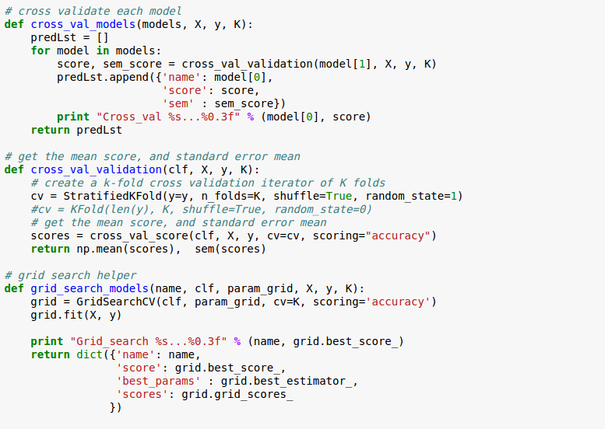
Code

Slide 22
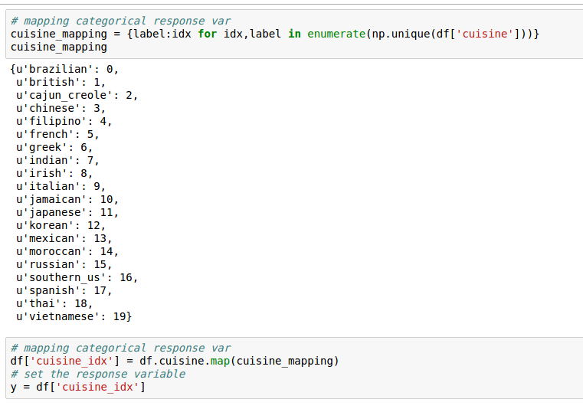
Response Variable

Slide 23
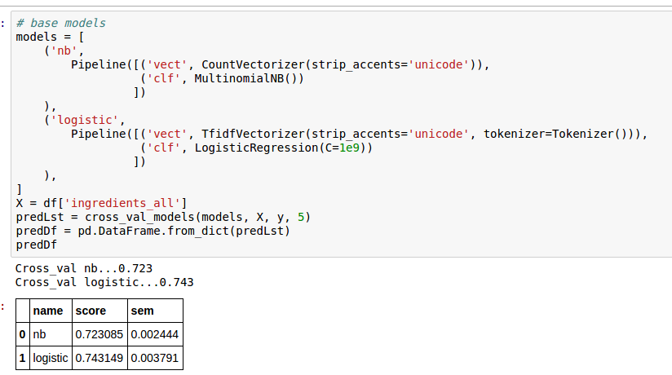
First Model

Slide 24
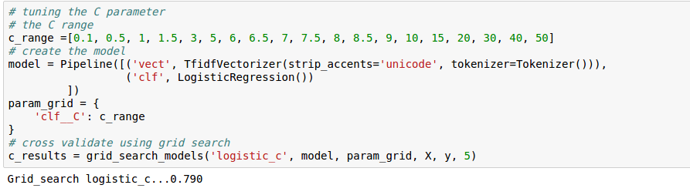
Logistic Regression Model (base)

Slide 25
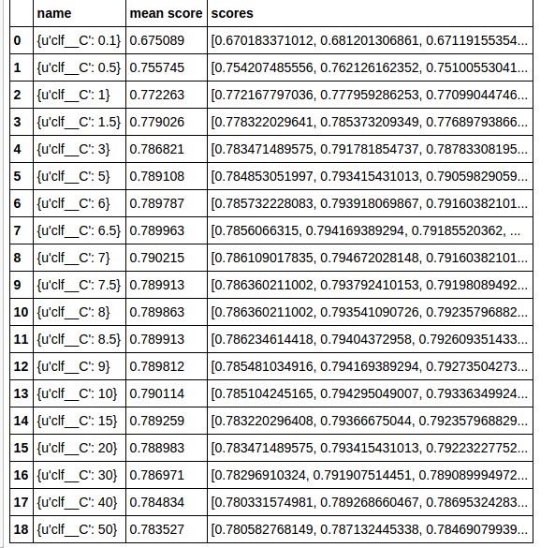
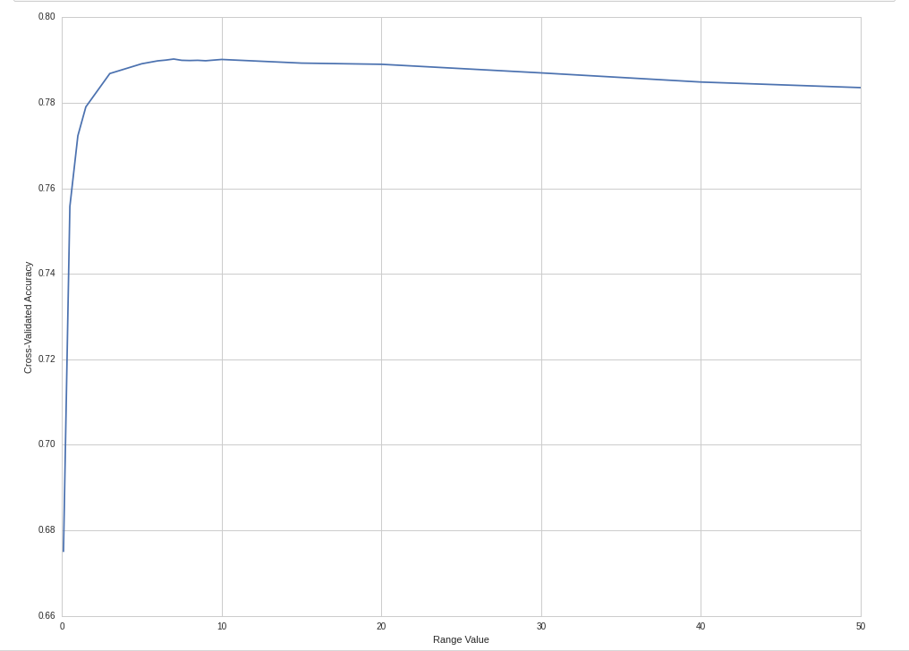
Logistic Regression Tuning
Tuning the C (inverse of regularization)

Slide 26
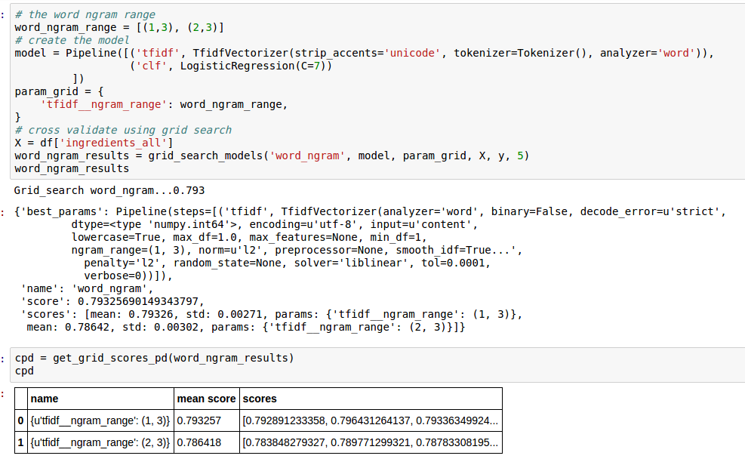
TFIDF Tuning (Word Ngram)

Slide 27
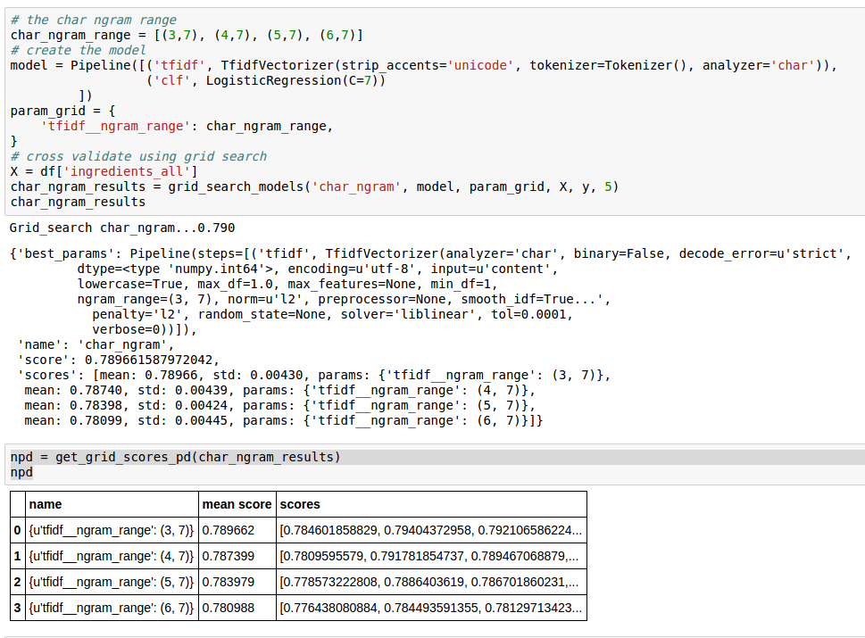
TFID Tuning (Char Ngram)

Slide 28
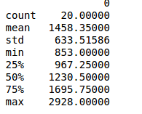
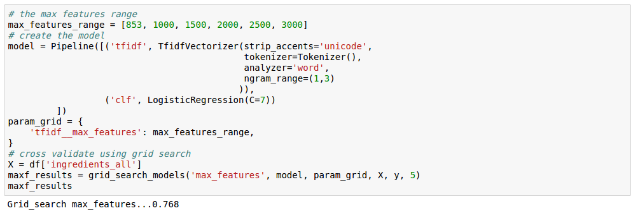
TFIDF Tuning (Max_features)
No improvement

Slide 29
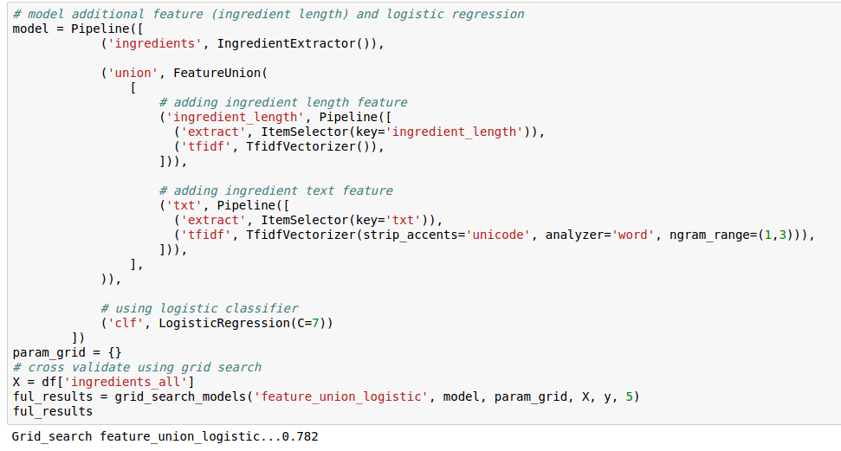
Adding Ingredient Length
No improvement

Slide 30
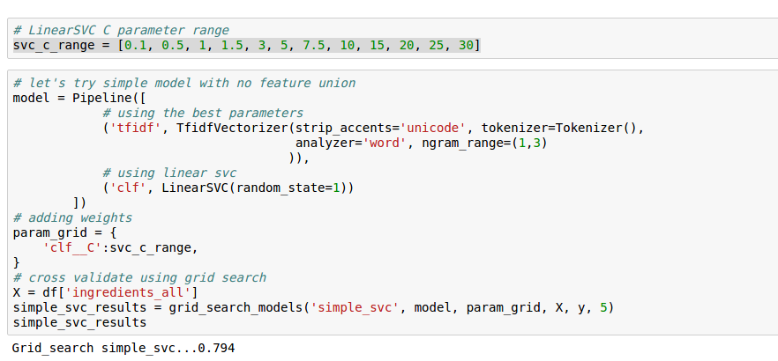
Linear SVC (base)

Slide 31
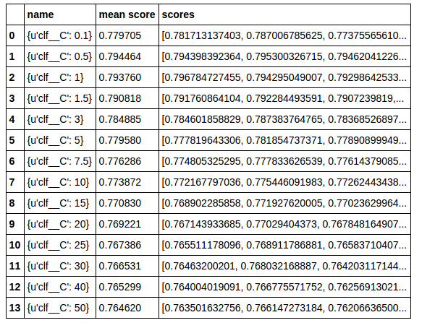
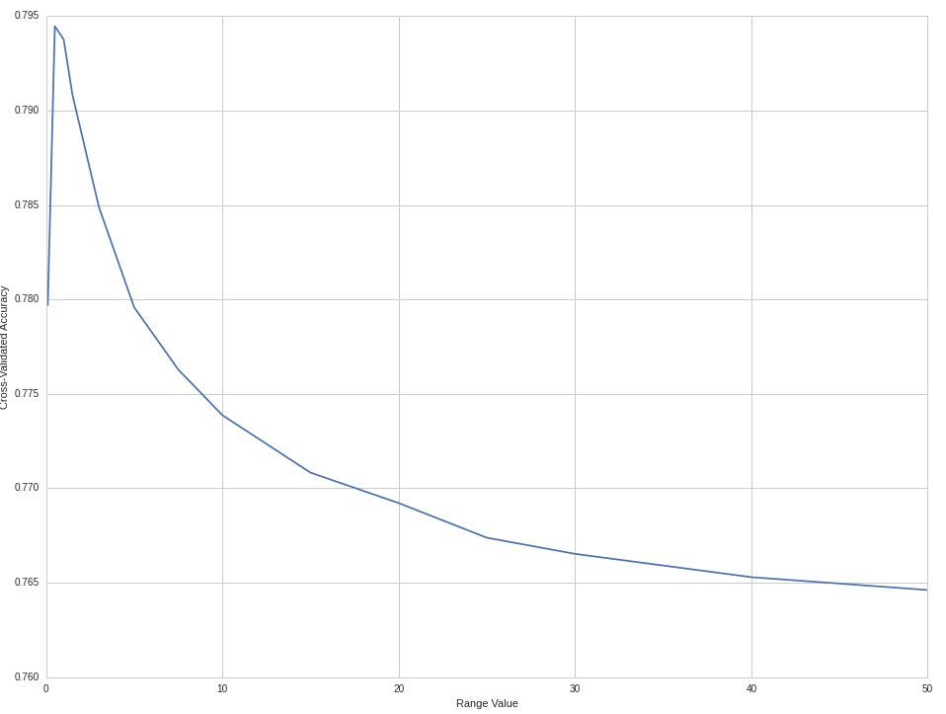
Linear SVC Tuning

Slide 32
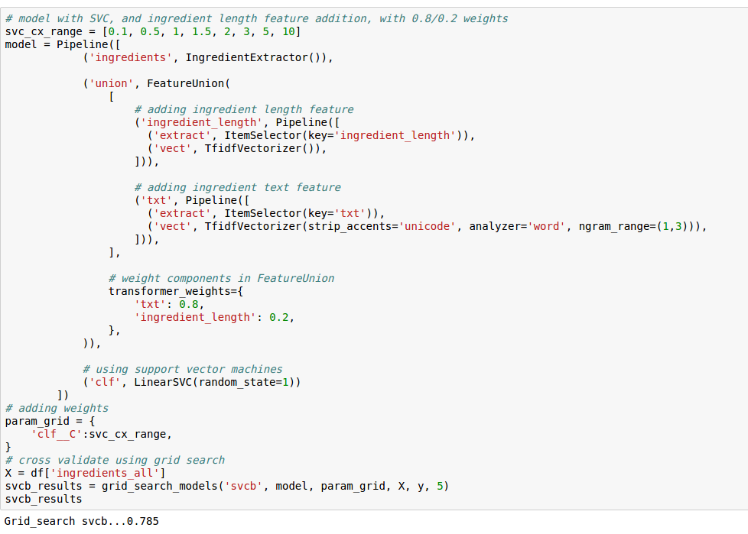
Linear SVC w/ Feature

Slide 33

Prediction

Slide 34



Prediction Result

Slide 35

Conclusion
Iterative approach to problem solving
Feature engineering is time consuming, but may improve the score.
Attempt different algorithms.

